Slide 1
Machine learning : King-country-houses
Vitor Almeida
Maryem Tlili
Jesus Hernandez

Slide 2
Table of Contents
Load the Data
Explore the data
Clean the data
Machine Learning :
  XGBoost Regressor
  CatBoost Regressor
  Random Forest Regressor
  KNN Regressor

Slide 3
2. Explore the data

Slide 4
2. Explore the data
The dataset has multiple features (21 Rows)
Most features are numerical, except “Date” which represents the date of House Sold out.
The dataset is complete, with no missing or anomalous values.

Slide 5
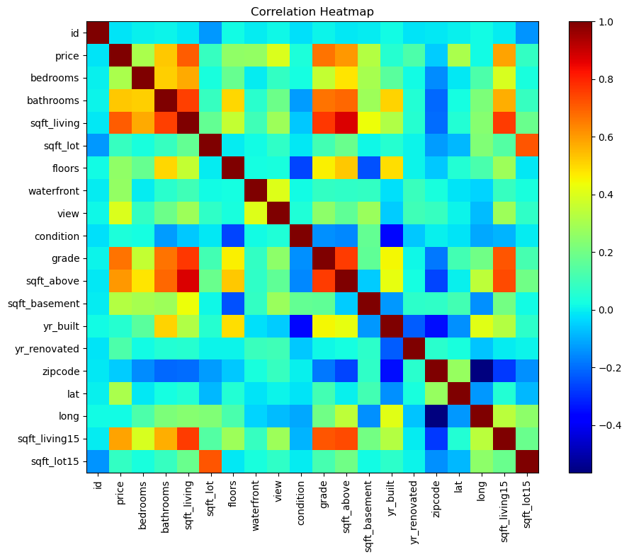
2. Explore the data
High correlations observed between: sqft_above & sqft_living grade & bathrooms
Independent features with low correlation include zipcode and id.

Slide 6
3. Clean the data

Slide 7
3. Data cleaning - Feature selection
id, date, view → Irrelevant for model learning.
sqft_living, sqft_above, sqft_basement, sqft_living15, sqft_lot15, lat, long
→ Redundant with sqft_lot; all are correlated and describe the house size.
condition → Overlaps with grade provides similar information.
zipcode → Categorical but represented as numerical values; difficult for the model to interpret meaningfully.
yr_renovated →low variability and limited predictive value.

Slide 8
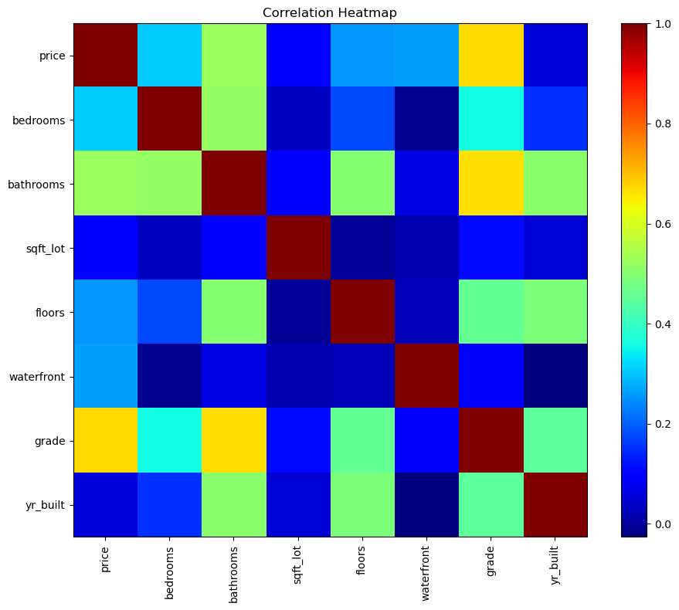
3. Data cleaning - Feature selection
After removing redundant columns,
no highly correlated features remain in the dataset.
This indicates a reduced risk of multicollinearity, ensuring the model can learn more effectively from the remaining features.

Slide 9
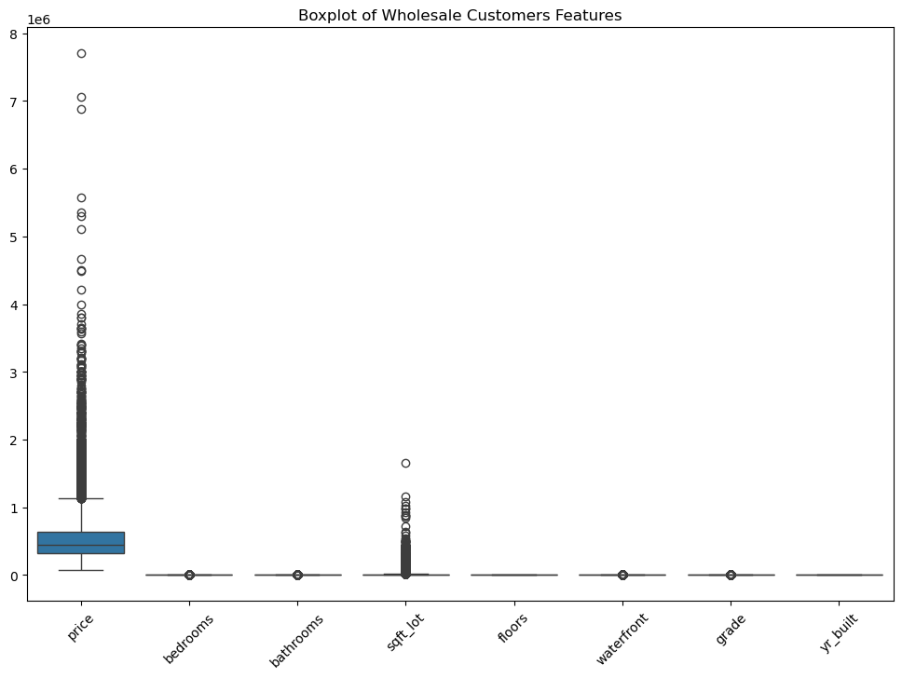
3. Data cleaning - Removing outliers
The features sqft_lot and price contain a high number of outliers.
We will keep these outliers for now, as removing them could exclude an entire segment of the housing market and reduce model representativeness.
Their impact may be reduced later through techniques such as log transformation.

Slide 10
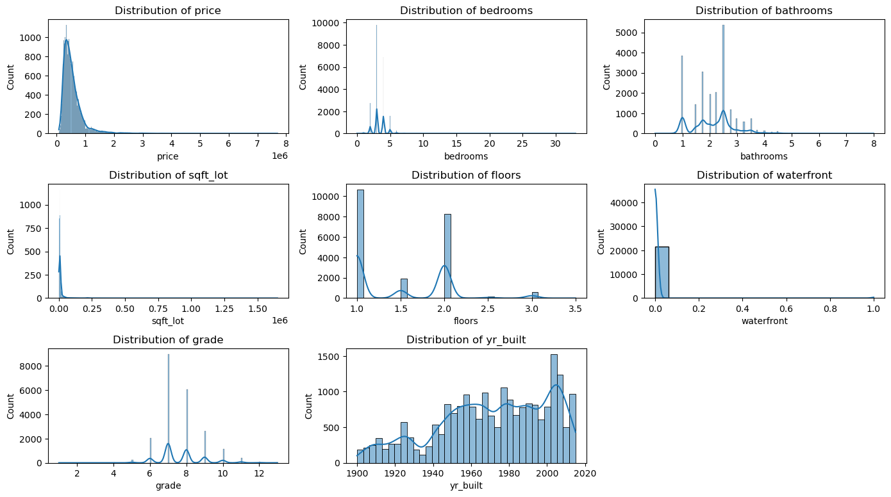
3. Data cleaning - Skewness correction
The dataset shows skewed features.
Skewness will be addressed later if needed, depending on model performance and sensitivity to the skewness

Slide 11
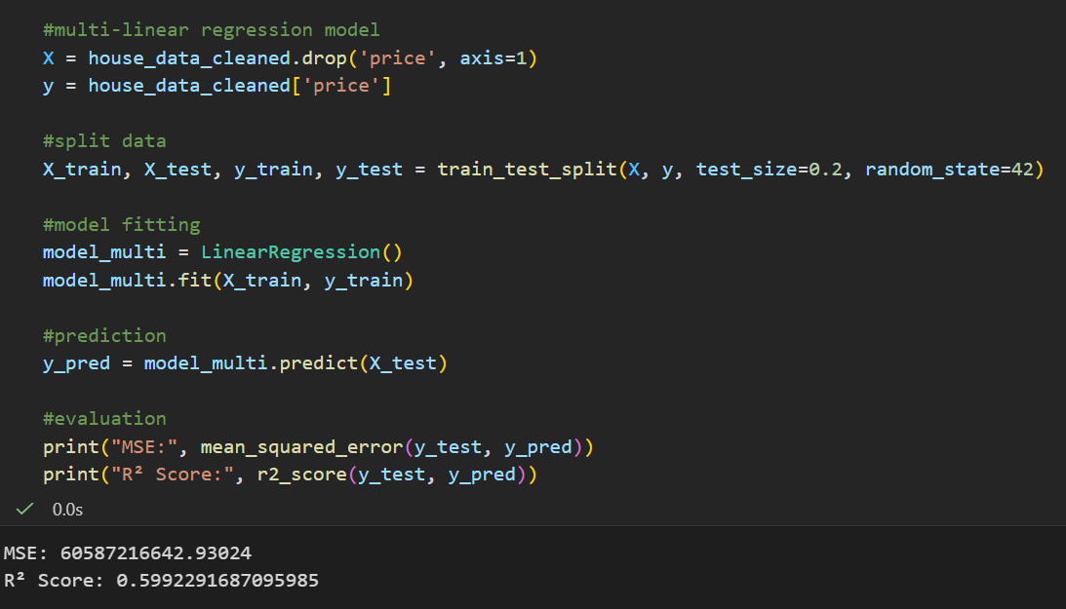
3. 1 Multilinear Regression - Initial model
We built an initial Multilinear model to measure the impact of the cleaning.
The R² score is low at this stage.
To improve it, we will replace year_built with a new feature house_age, which is easier for the model to interpret.

Slide 12
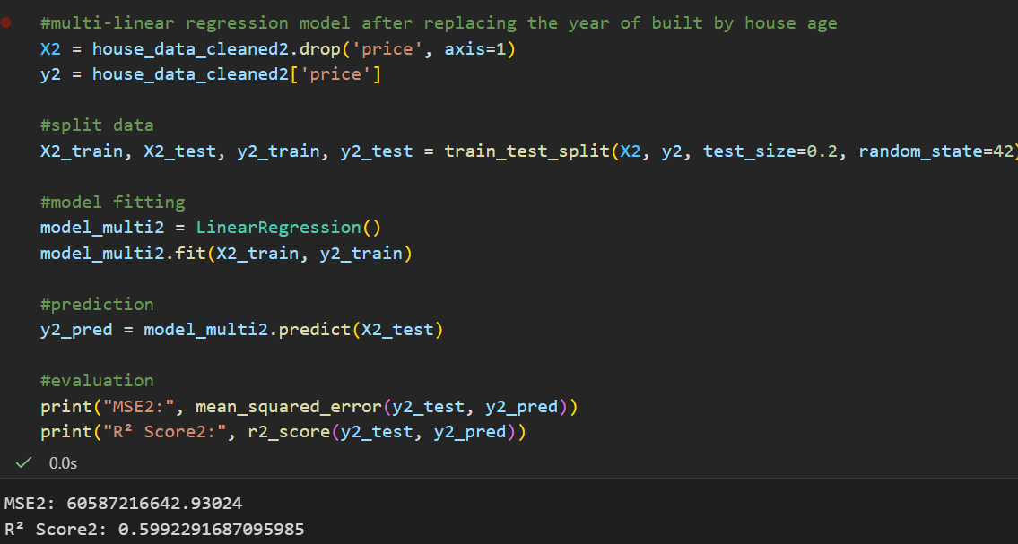
3. 1 Multilinear Regression - Feature Engineering impact
Dropping year_built slightly increased the R² score by 0.000024.
The score remains low.
Next step: build a StatModel to analyze p-values and identify the most significant features.

Slide 13
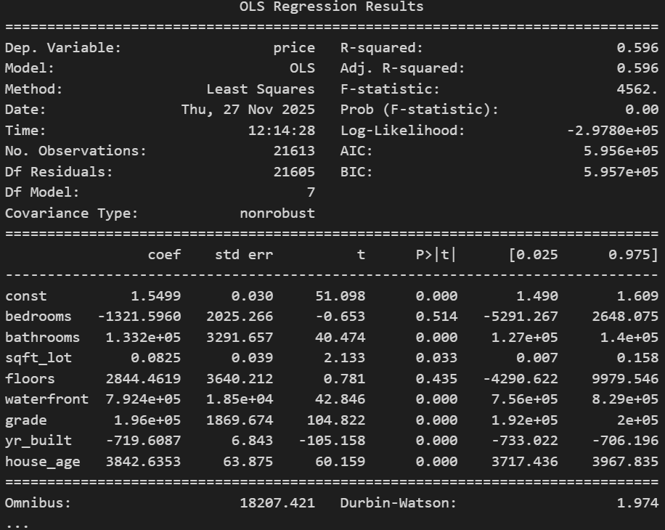
3. 1 Multilinear regression- Feature selection impact
bedrooms and floors have p-values > 0.05, indicating they do not significantly impact the model.
These features will be removed to improve model performance

Slide 14
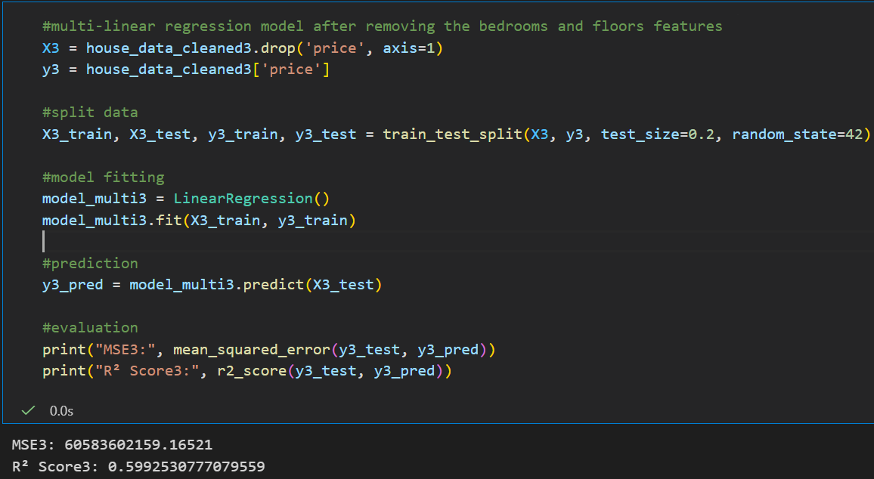
3. 1 Multilinear regression - Feature selection impact
After removing floors and bedrooms:
R² score remained the same.
MSE (Mean Squared Error) decreased slightly, indicating a minor improvement in model accuracy.

Slide 15
3. 1 Multilinear regression - Skewness correction
Right-skewed features:
sqft_lot (skewness = 13.06)
price (skewness = 4.02)
bathrooms (skewness = 1.10)
waterfront (skewness = 5.22)
grade (skewness = 0.67)
Left-skewed feature:
house_age (skewness = -0.60)
Skewness may be contributing to low model performance.
Log transformation is considered for sqft_lot and price due to high skewness and outliers.

Slide 16
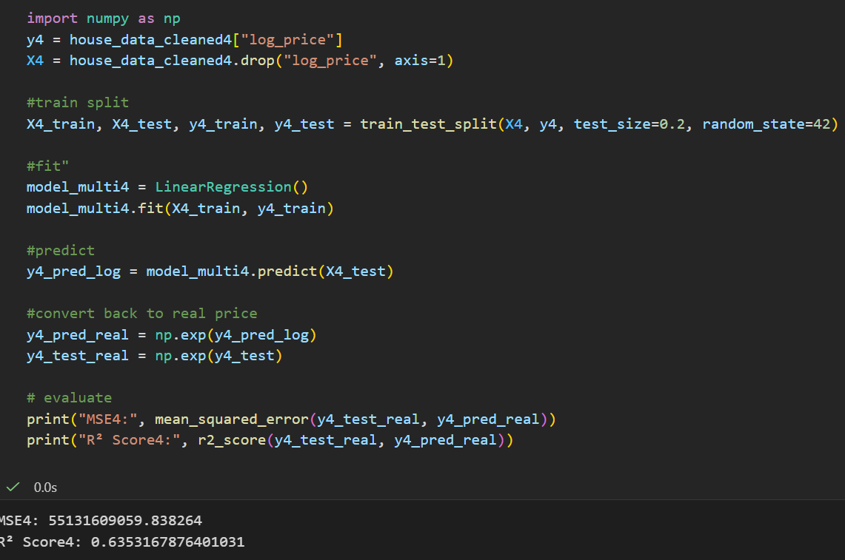
3. 1 Multilinear regression - skewness correction impact
R² score improved significantly to 0.63
MSE decreased considerably → model performance improved
Next steps: Apply Ridge regression to further enhance performance

Slide 17
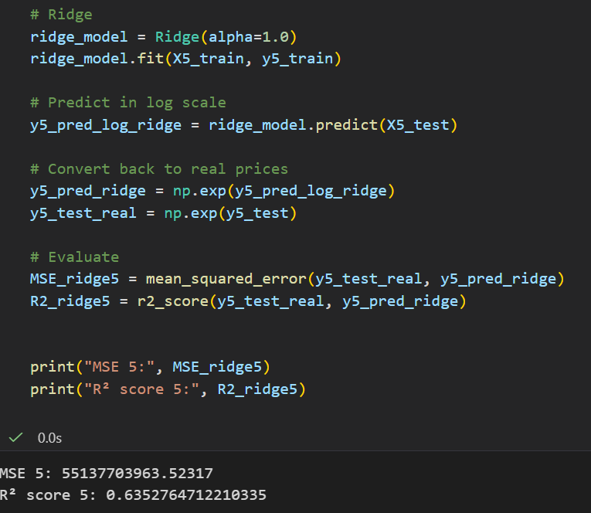
3. 1 Multilinear regression - Ridge Regression
Applying Ridge regression slightly decreased the R² score by 0.00004.
Indicates that we may have reached the maximum performance with linear regression on this dataset.
Next step: Explore a different model using the same dataset for potential improvement.

Slide 18
4. Machine Learning
XGBoost Regressor

Slide 19
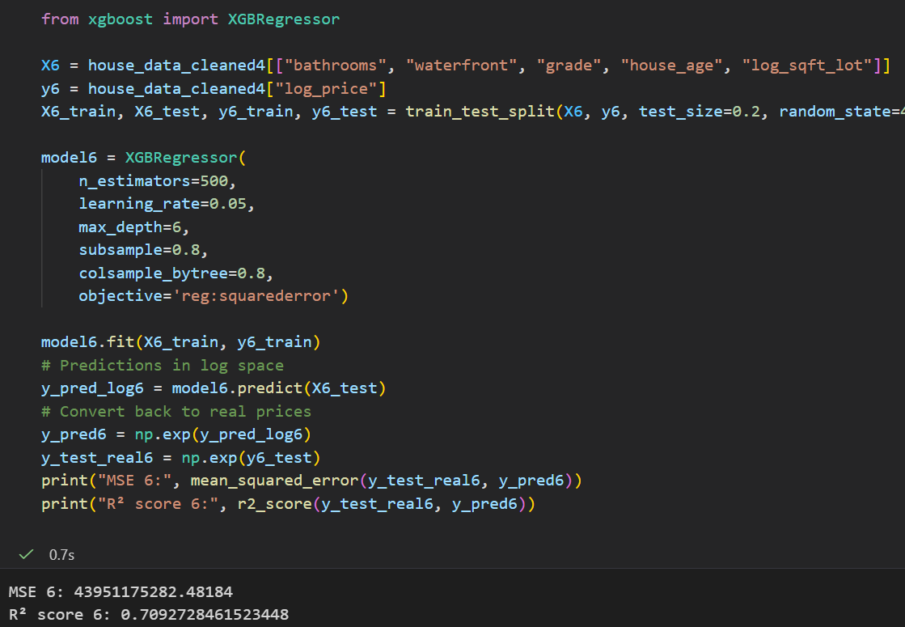
4.a Machine Learning - XGBoost Regressor
Using the same dataset, XGBoost Regressor achieved R² = 0.70
Next goal: Improve XGBoost performance by changing hyperparameters
Hyperparameter optimization methods:
Random Search / Optuna
Calculations will be performed using Google Colab

Slide 20
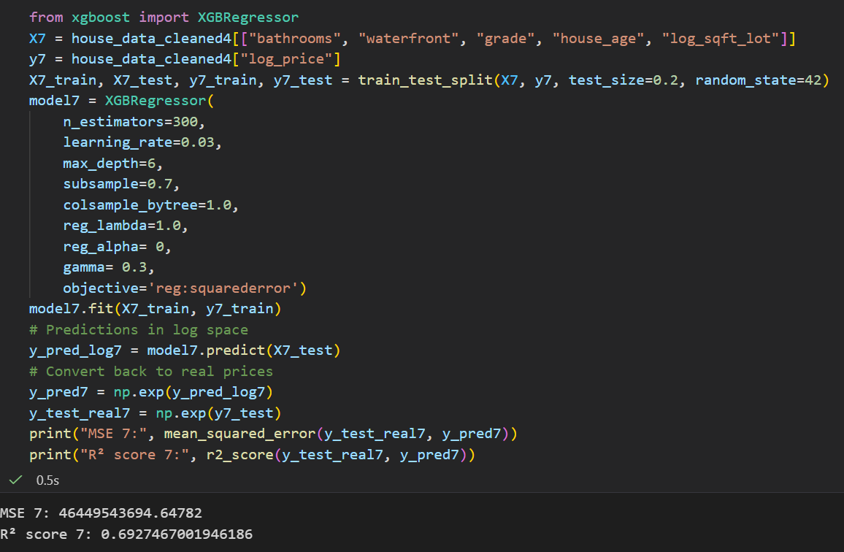
4.a Machine Learning - XGBoost Regressor
Using Random Search for hyperparameter:
R² score decreased slightly to 0.69
Features might be very reduced and that is limiting the model performance

Slide 21
4. Machine Learning
CatBoost Regressor

Slide 22
4. Machine Learning - Adding features
New features to add: condition, yr_renovated, lat, long
Data cleaning:
Convert yr_renovated into a binary feature:
  0 → house not renovated
  1 → house renovated
Next model: Apply CatBoost Regressor on the updated dataset

Slide 23
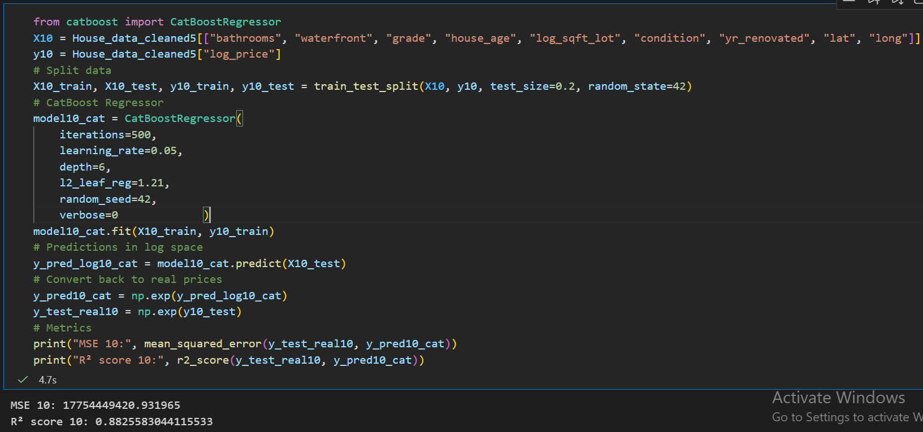
4.b Machine Learning - CatBoost Regressor
R² score reached 0.88

Slide 24
4. Machine Learning
Random Forest Regressor

Slide 25
4.c Machine Learning - Random Forest Regressor
We had to make some specific data processing before running the Random Forest regressor

Slide 26
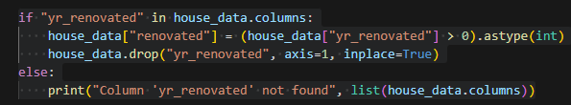
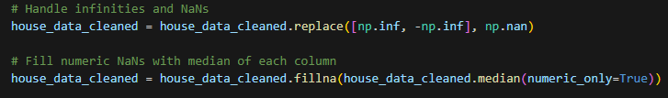
4.C.1 . Feature Engineering and Normalization
Binary feature for renovation
Binary feature for renovation
House age: Transform yr_built → house_age
Handling bad values:
Replace infinities or NaNs with the column median

Slide 27
4.C.2. Feature Engineering and Standardization
Limiting Top 1% on the rows mentioned ( with more outliers ) reduced data size :
From 21,613 rows → 20,536 rows

Slide 28
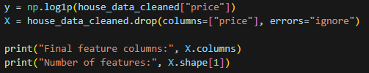

4.c Machine Learning - Random Forest Regressor
I used np.log1p() to shrink the large numbers while keeping the small ones meaningful, also won’t crash if divided by 0.
Split the data 80% training and 20% testing.

Slide 29
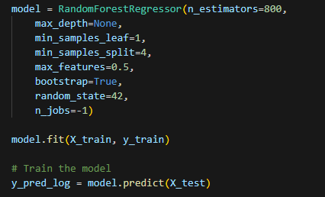
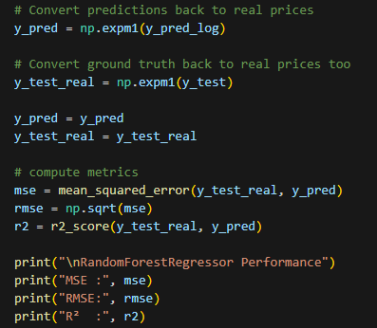
4.c Machine Learning - Random Forest Regressor
RandomForestRegressor Performance
MSE : 8988373363.432673 _ RMSE: 94807.0322467309
R² : 0.8491315430228875
An R2 of approximately of 0.85 means the model is a good house predictor

Slide 30
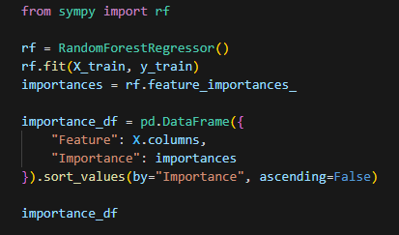
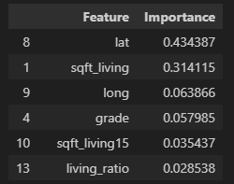
4.C Machine learning - Random Forest Regressor - Evaluation
Feature importance:
- The model creates a score for each column.
- The score will tell how much it helped reduce prediction error across all the trees.
- The higher the number the more the model relied on the column.

Slide 31
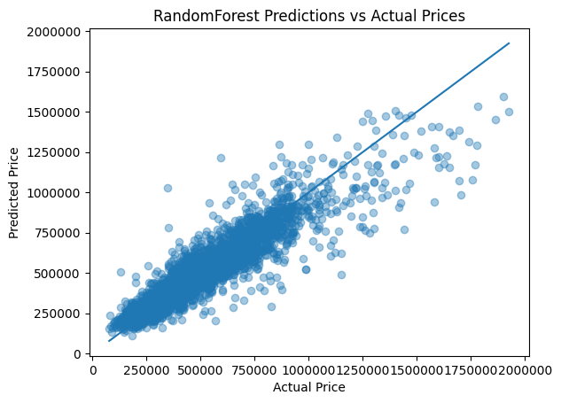
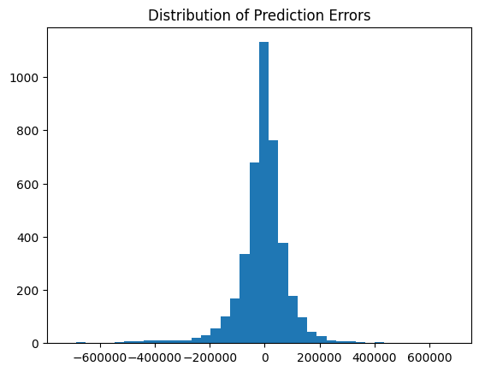
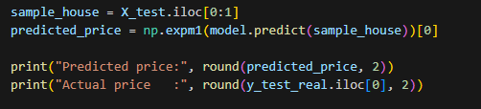
4.C Machine learning - Random Forest Regressor - Evaluation
With this test the model is off by 19% of a house pricing.
Predicted price: 406936.29
Actual price: 538250

Slide 32
4.C Machine learning - Random Forest Regressor - Evaluation
With this test the model is off by 19% of a house pricing.
Predicted price: 406936.29
Actual price: 538250

Slide 33
4. Machine Learning
KNN Regressor

Slide 34
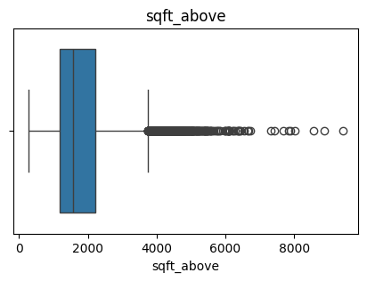
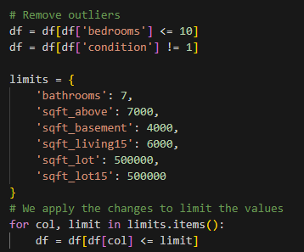
4.d Data cleaning - Removing outliers
Many features contain a high number of outliers.
KNN is highly sensitive to outliers also variables need to be normalized

Slide 35
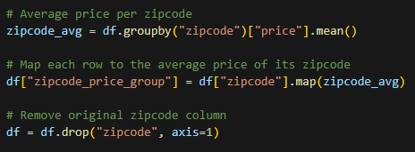
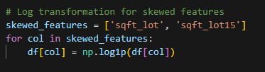
4.d KNN – model splitting data and treatment
Grouping zipcode by its price mean reduced the number of categories, giving the KNN model a smoother, more compact representation.
Applying log1p reduced feature skewness, making distributions more normal and stabilizing the model against extreme values.

Slide 36
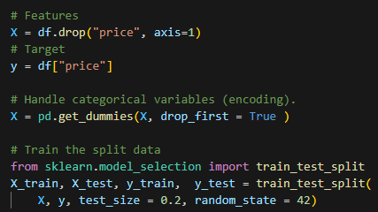
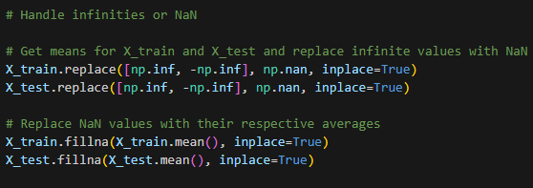
4.d 1 KNN – model splitting data and treatment
Before using KNN is necessary Scaling and Normalization:
For this case, if we didn’t treat NaN or infinites, the model wouldn’t work

Slide 37
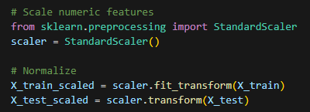
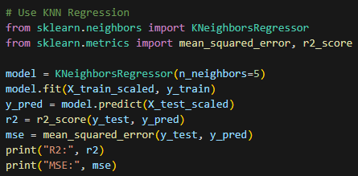
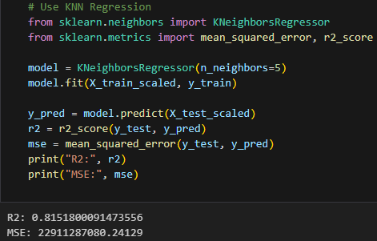
4.d KNN – model splitting data and treatment
Normalization and scaling are crucial in KNN regression because the algorithm relies on distance; without it, features with larger ranges dominate the predictions
Results:
  R² score
  MSE:

Slide 38
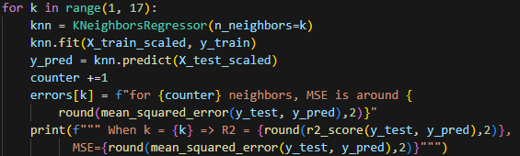
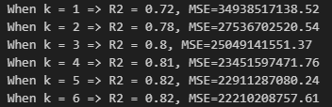
4.d KNN – model splitting data and treatment
We check how numbers of neighbors may impact R2 and MSE
The most optimal range for neighbors is around 3 and 6

